Slide 1
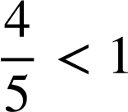

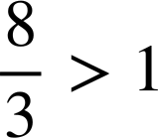
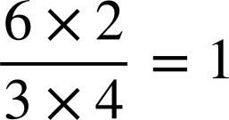

Checking and securing converting improper fractions to mixed numbers
Task A: Proper and improper fractions
Insert the inequalities = ,﹥and﹤to make the statement true
a)
c)
b)
d)
2) Identify if the following are true or false
Statement | True | False
The value of a proper fraction is always less than 1
The value of an improper fraction is always greater than 1
A fraction in the form a/b where a>b is an improper fraction
789 ÷ 788 will give a number greater than 1
3) Without calculating the answer,
which letter corresponds to the calculation
5677 ÷ 5678 is letter
5678 ÷ 5678 is letter
5679 ÷ 5678 is letter
5678 ÷ 2880 is letter

Slide 2
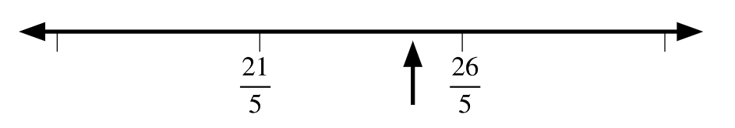
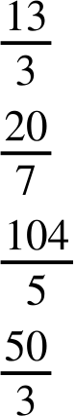
Checking and securing converting improper fractions to mixed numbers
4) Here is a section of a number line
Which whole number is the arrow pointing to?
Approximately mark another two whole numbers on the number line. What are these whole numbers?
How would your answers change if the denominator was 6?
What could the denominator be if there were no whole numbers between the two fractions?
Task B: Changing improper fractions to mixed numbers
1) Write the mixed number of the following improper fractions.
a)
b)
c)
d)

Slide 3
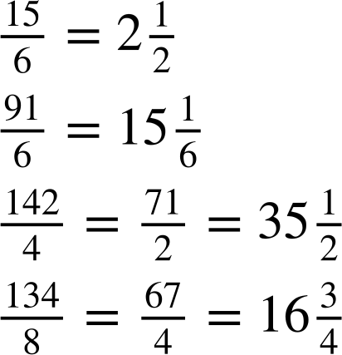
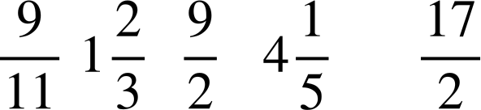
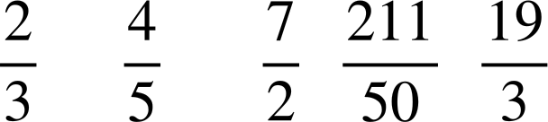
Checking and securing converting improper fractions to mixed numbers
2) Fill in the blanks.
a)
b)
c)
d)
3) Put the following numbers in ascending order, smallest to largest. Converting to a mixed number may help.
a)
b)
Mathematics in Education and Industry
v2.1

